Slide 1

Ministry/Organization Name/Student Innovation: AICTE, MIC-Student Innovation
PS Code: SIH1490
Problem Statement Title: Student Innovation
Team Name: ZapX
Team Leader Name: KSHITIZ GAUR
Institute Code (AISHE):
Institute Name: BVCOE ,DElHI
Theme Name:
ZapX

Slide 2
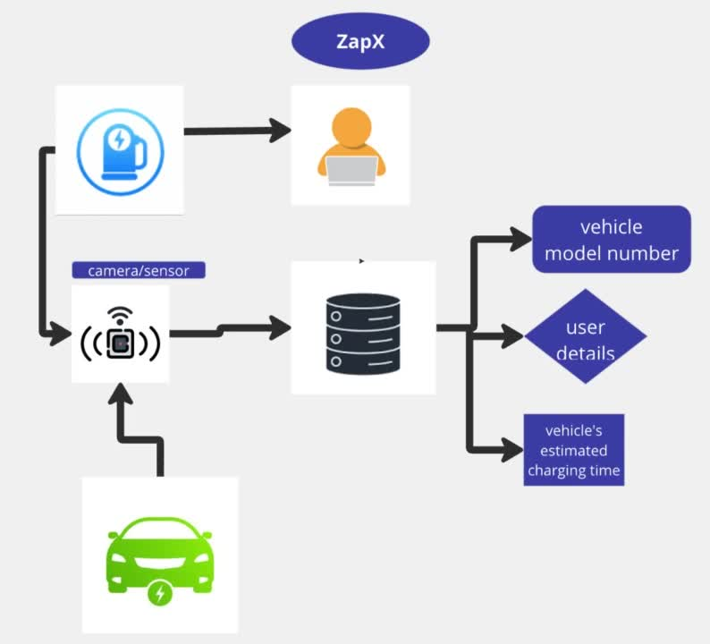


FLOWCHART :
IDEA :
Electric vehicles are quickly becoming the future of transportation. With increasing concerns over the environment and rising fuel costs, more and more people are turning to EVs as a viable alternative to traditional gas-powered cars.
However, one major challenge that EV owners face is the need for a reliable charging infrastructure. Without a network of charging stations, EV drivers are limited in their ability to travel long distances or even use their vehicles for daily commutes. This is where our solution comes in.
TECHNOLOGY STACK :
HTML
CSS
JAVA

Slide 3



KEY
FEATURES
USP
1.Charging Station Locator
2.Journey Planning
3.Payment Gateway
Integration
ZapX streamlines the entire EV charging process, offering convenience, efficiency, and peace of mind to EV owners.
How We Stand Out:
1.Real-time Station
Status Updates
2.Personalized Estimated
Charging Time

Slide 4



LIMITATIONS
1
2
3
Use of hardware :- The unique selling proposition of the project shows dependency on hardwares like camera for monitoring the traffics on the charging station , sensors for obtaining the data of vehicle charging and estimated time for charging.
Requirement of data from government ministry :- the project also required data from the ministry , the data of the vehicle owner about the vehicle type and charging information of government charging stations .
Use of ai and internet connectivity for real time tracking and efficient automation:- the project aims to present real time and true data to their users. The automations and tracking processes will require good internet connectivity and will be using ai for automation purposes.

Slide 5



TEAM MEMBER DETAILS
Team Leader Name: KSHITIZ GAUR
Branch :BTECH Stream :CSE Year : II
Team Member 1 Name: PALLAK KHULLAR
Branch:BTECH Stream : ECE Year :II
Team Member 2 Name: NITYA MAHAJAN
Branch :Btech Stream : CSE Year : II
Team Member 3 Name: AMAN RAGHAV
Branch : Btech Stream : ECE Year : II
Team Member 4 Name: BHAVYA JAIN
Branch : Btech Stream : CSE Year : II
Team Member 5 Name: KRISH MUTREJA
Branch : Btech Stream : ECE Year : II
Team Mentor 1 Name: Type Your Name Here
Category (Academic/Industry): Expertise (AI/ML/Blockchain etc): Domain Experience (in years): Team Mentor 2 Name: Type Your Name Here
Category (Academic/Industry): Expertise (AI/ML/Blockchain etc): Domain Experience (in years):

Slide 6


Thank You

